Slide 1

Power Enjoy
Accademic Year 2016/2017
RASD Presentation
Politecnico di Milano
Software Engineering 2
Simone Bruzzechesse
Luca Franceschetti
Gian Giacomo Gatti

Slide 2
introduction 1
The goal of our project is to design and develop a digital management system for car-sharing service.
This system employs exclusively electric cars.
The system should provide classic functionality provided by generic car-sharing service, like car’s reservation or payment thought mobile application
User should be able to register to the system himself by providing personal information
Through mobile application, registered user should be able to find a car within a certain distance from current location or from a specific address
The system provides also the possibility to reserve a single car

Slide 3
introduction 2
Car-sharing system initiate the charging of money as soon as the engine ignites, and the system starts charging the user for a given amount of money per minute
The user is notified of the current charges through a screen on the car
The system stops charging the user as soon as the car is parked in a safe area and the user exits the car
The set of safe areas for parking cars is predefined by the management system, so we can query database to decide if the car is parked in a safe area
The system must be able to define certain user’s behavior and apply some discount (or charging) in consequence
Users will be able to register himself before the first rent, or to register himself with a web application created to improve the comfort of registration

Slide 4
Actors
Actors of our system are essentially two, even if the second one is much more important and assume different states according to how he/she is interacting with the system.
Guest: a guest is a person who is not registered in the system yet. He cannot use features of the system until he/she sign up.
User: a user is a person that has already signed up into the system. When a user logs in, we mean him/her as a LOGGED USER. The logged user can take advantage of every feature of our system, and depending on what his actions are he/she can be a simple user or a driver.

Slide 5
assumption and dependencies 1
We deliver the payment management at the end of the trip to an external system that is able to handle this situation, so it can manage also some exceptions that can occur during the payment. For instances the user could not have enough money to conclude the transaction
We assume that the fee is payed as soon as the reservation expires
The payment of the trip is made as soon as the user leaves the car if he doesn’t select the possibility to plug the car (or if he is not able to do that), while if he chooses this option the payment is postponed of 2 minutes because the system allows him to plug the car. Then if the system, after two minutes, detects that the car is plugged it will apply the discount, otherwise not
Since “the user leaves the car” and “the user is near the car” are ambiguous, we assume that a user is near the car or is leaving it if the distance (calculated from the two GPS) between them is smaller/bigger than a certain amount.

Slide 6
assumption and dependencies 2
We assume that the charging stations are always available and perfectly working. If not, we assume that they are immediately repaired by the employees of the system.
Since we exactly know, thanks to Placemeter, how many people are actually in the car we can apply the 10% discount only to part of trip where the passengers were at least 2. For instances if during the first half of the trip there were 3 passengers on the car and then they were dropped off, so the user finishes the trip on his own, then the discount is applied only to the first half of the trip.
We assume that if one car’s charge is less than 5%, then it encourages the user to stop the trip as soon as possible. As the car is left it won’t be able for others trip until one of the employee of the system take care of bringing it to the nearest charging station and plugging it. So, when the car’s charge will be again upper than a certain percentage it will be available again for the users.

Slide 7
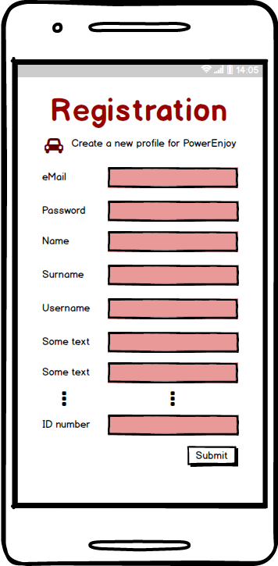
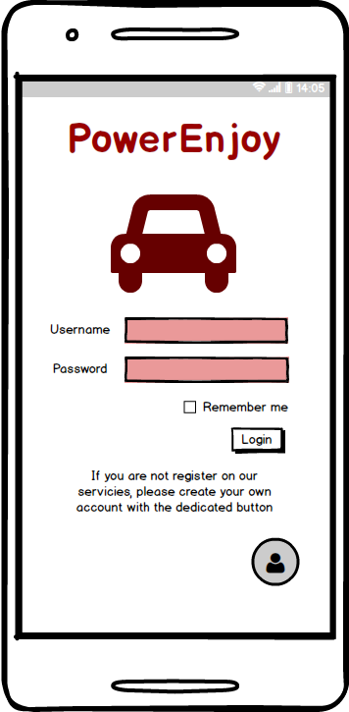
Mockups
Registration and login

Slide 8
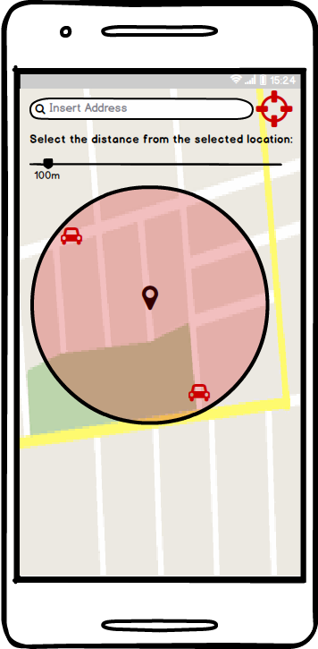
Mockups
Research a car

Slide 9
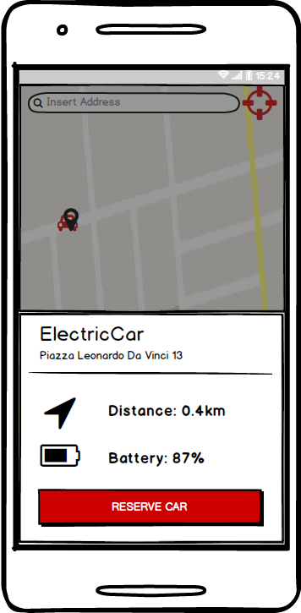
Mockups
Select a car, view status and reserve it

Slide 10
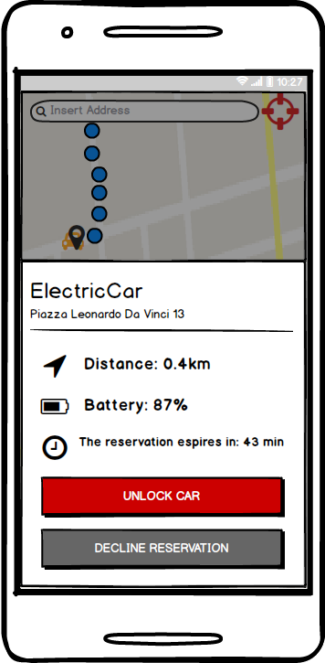
Mockups
Unlock the car

Slide 11
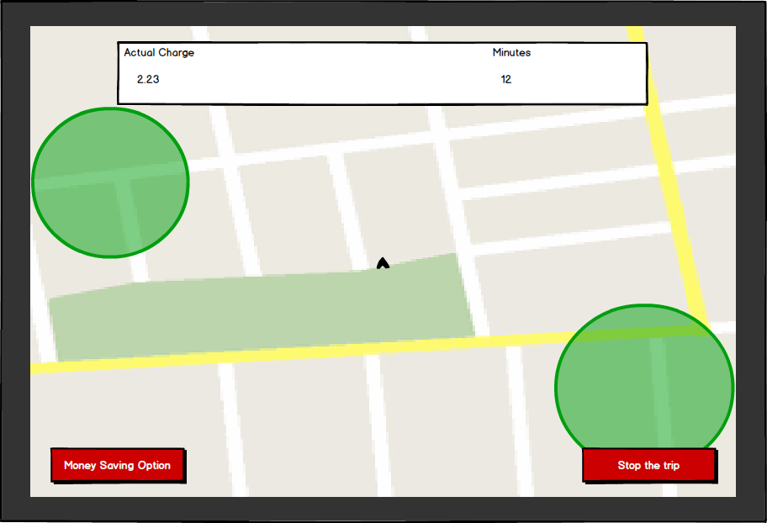
Mockups
View charge during the trip

Slide 12
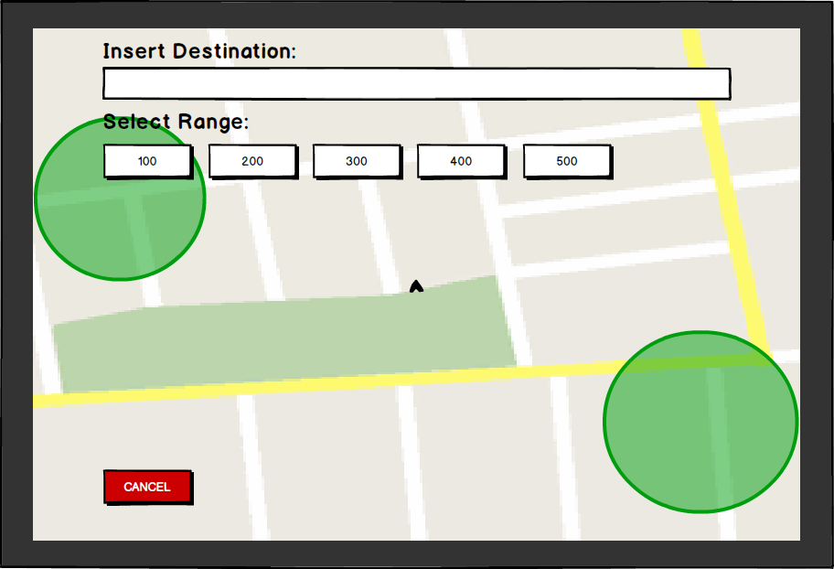
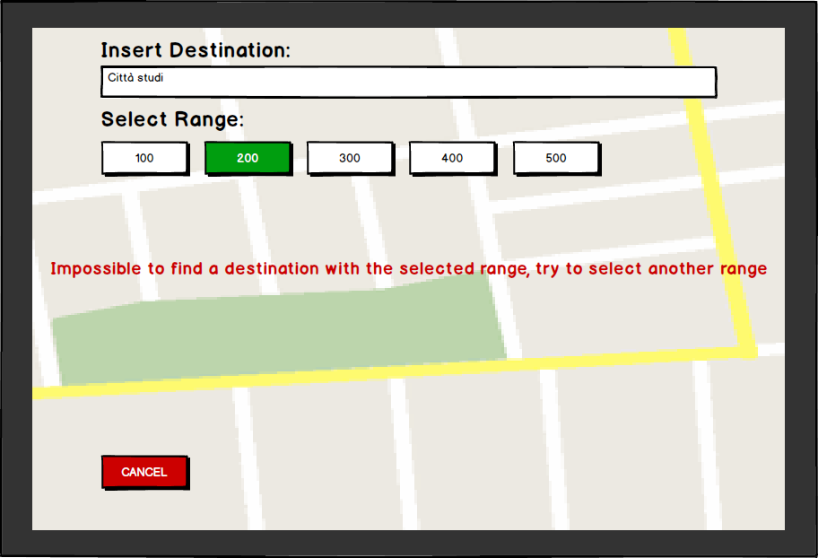
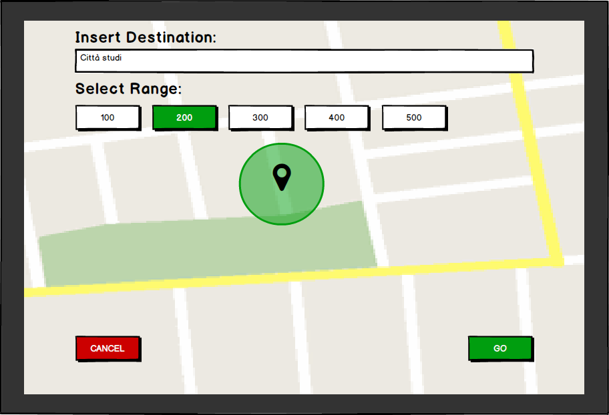
Mockups
Enable “money saving” option

Slide 13
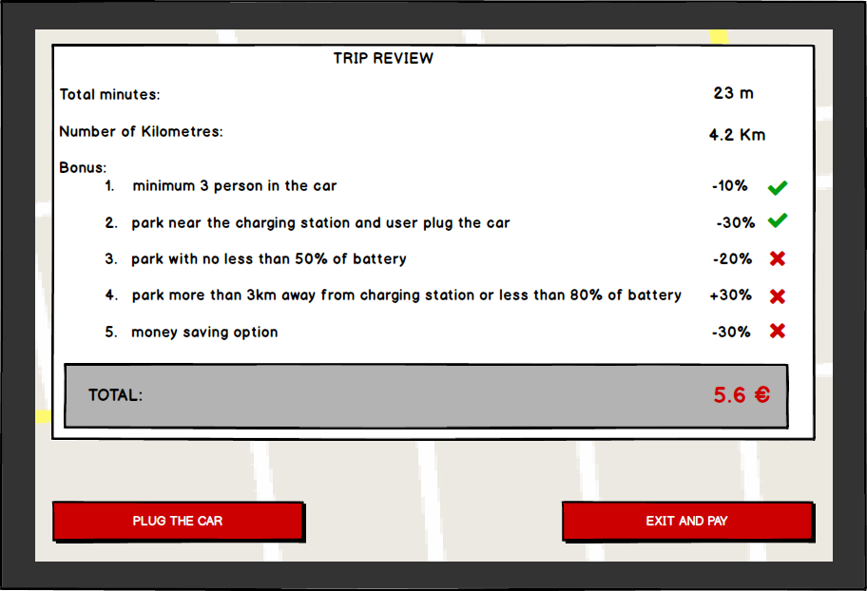
Mockups
Conclude the rent and pay

Slide 14
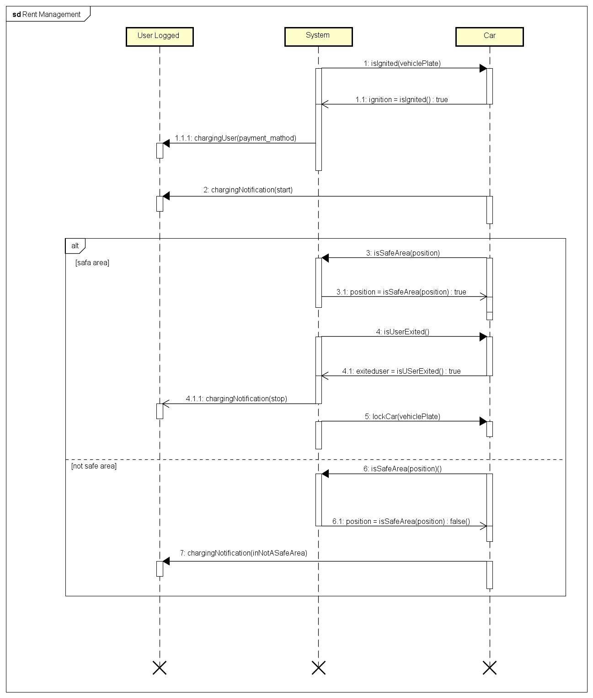
s
e
q
u
e
n
c
e
d
i
a
g
r
a
m

Slide 15
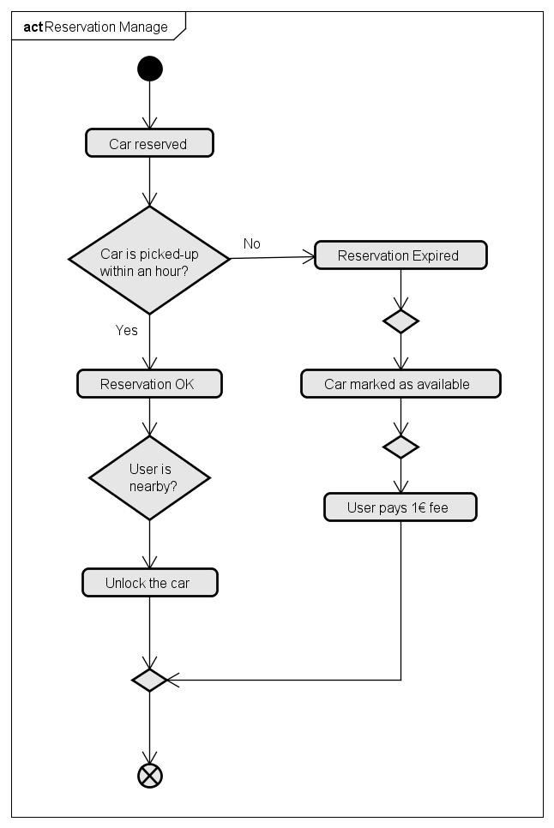
activity diagram

Slide 16
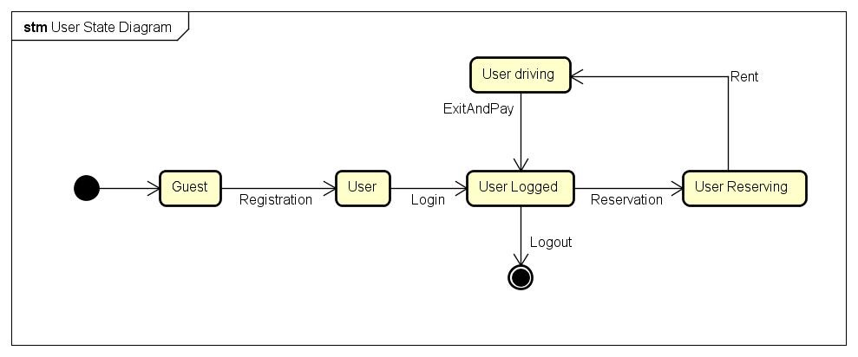
State diagram

Slide 17
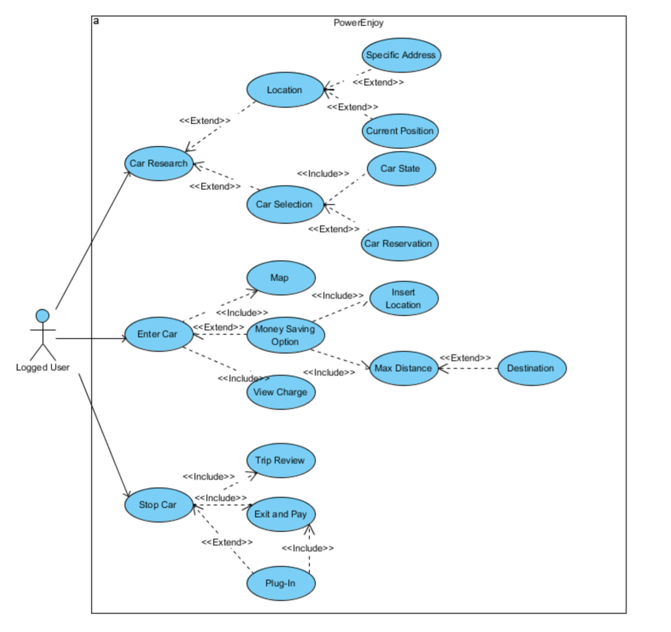
use case diagram

Slide 18
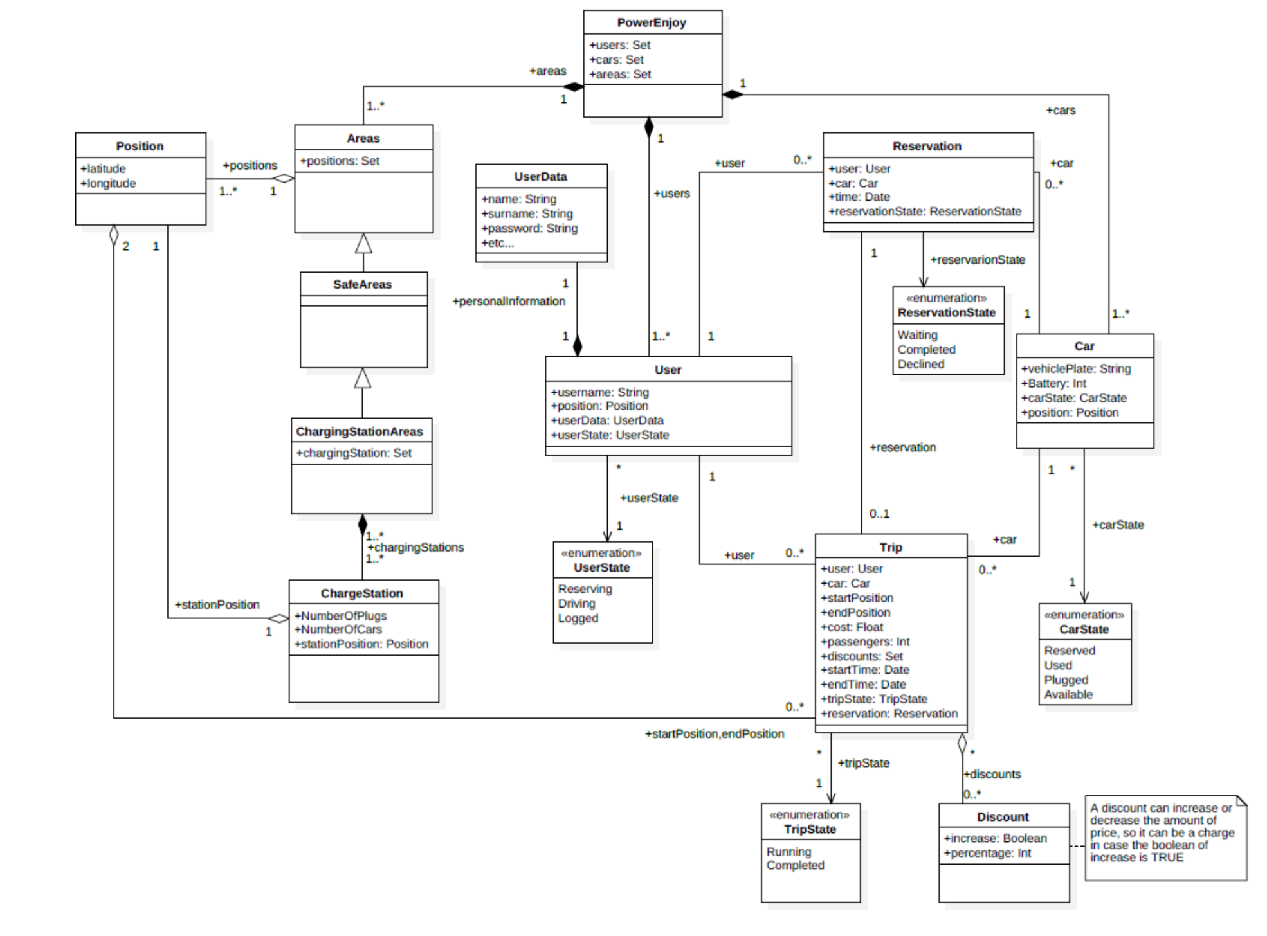
class diagram

Slide 19
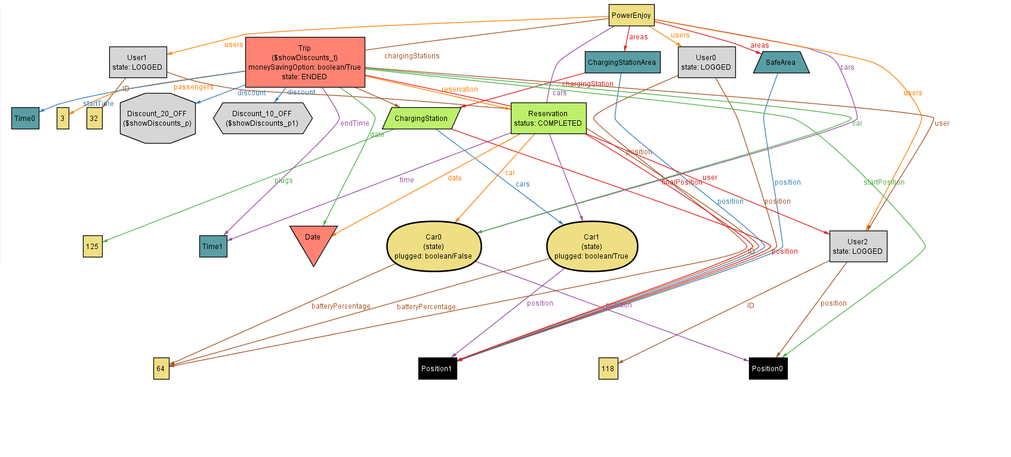
alloy model 1
Trip ended with discount

Slide 20
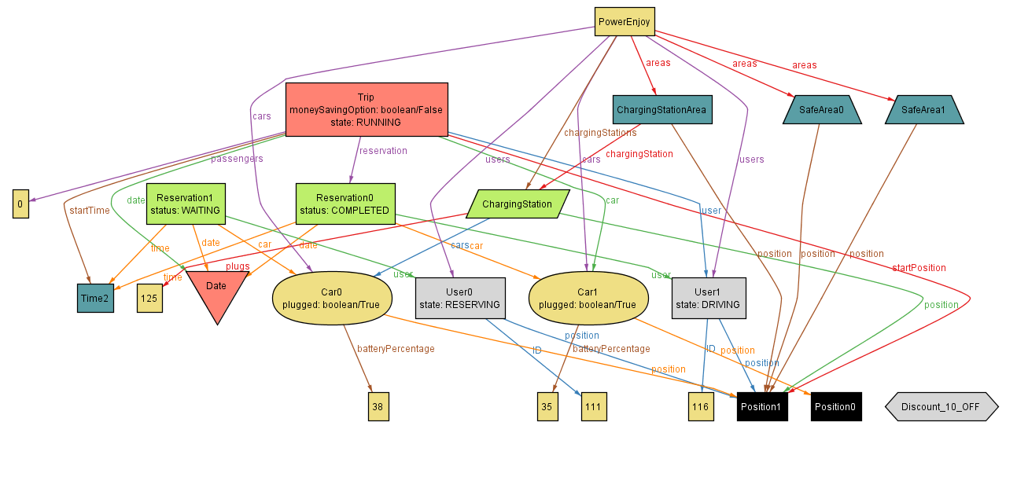
alloy model 2
Reservation waiting

